Slide 1
IE509-Python Project
Implementing Principal Component Analysis
from scratch
The purpose of our project is to self-explore and understand the deep mathematical principles behind Principal Component Analysis (PCA).
We are not going to import PCA directly from scikit-learn.
We are going to implement PCA from scratch step by step.
NAME-HEMANTH KUMAR
ROLL-24N0459
NAME-SUNRIT PAL
ROLL-24N0456
Under the supervision of:
Professor P Balamurugan
Professor Urban Larsson

Slide 2
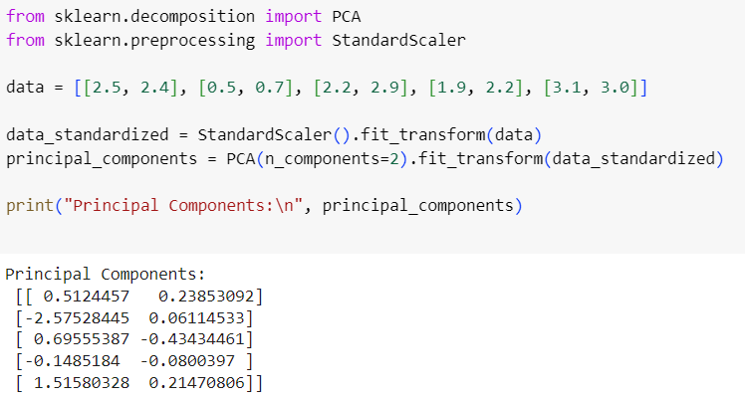
Using PCA directly from scikit-learn
As we can see the principal components are being calculated but it is like a Blackbox where we don’t have the understanding of the inner working of how it is being done.

Slide 3
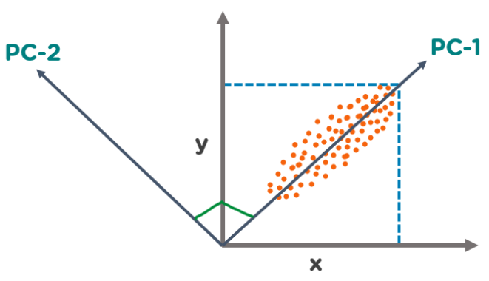
Objective of Our Project
We want to understand the mathematical principles involved behind PCA such as Scaling, calculating the covariance matrix, eigen-decomposition of covariance matrix, choose the principal components and then projecting our data on these principal components to get our dimensionally reduced data.
Image Credit: www.simplilearn.com

Slide 4
The Need for doing PCA
PCA is needed to reduce the dimensionality of large datasets, making them easier to visualize and analyze while preserving the most important information (variance).
Improved Computational Efficiency: Speeds up processing and model training by reducing the complexity of the data.
Data Visualization: Enables visualization of high-dimensional data in 2D or 3D by projecting onto the principal components.
Pattern Recognition: Identifies underlying patterns or structures in the data that might not be obvious in high-dimensional space.
Variance Capture: PCA identifies directions (principal components) in which the data varies the most. These directions often correspond to meaningful patterns or trends in the data.

Slide 5
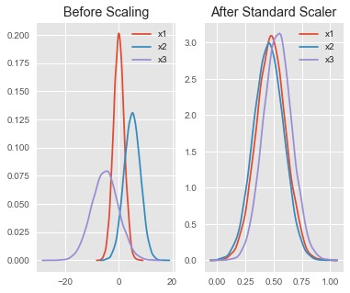
Data Preprocessing-Scaling
Why Scaling?
Without Scaling: PCA may fail to capture meaningful patterns if features have different units or ranges. Principal components may be misleading, and the reduced data might not accurately represent the original dataset's structure.
With Scaling: Each feature contributes equally to the variance, allowing PCA to find components that better capture patterns across all features. The principal components will then represent a balanced summary of the dataset’s structure.
We use the following formula for standardizing the data:
X’=(X-u)/sigma.
X is the original feature vector u is the mean and sigma is the standard deviation of X.
X’ is the new standardized data.
Image Credit: www.stackoverflow.com

Slide 6
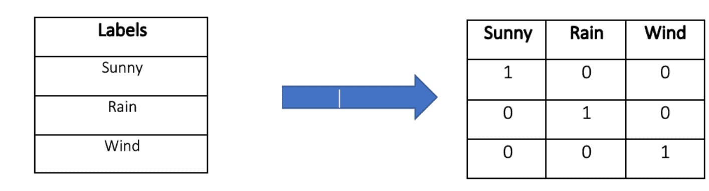
Data Preprocessing-One Hot Encoding
The purpose of using one-hot encoding is to convert categorical data into a numerical format by representing each category as a binary vector, where each vector element corresponds to a unique category and has a value of 1 for the presence of that category and 0 for its absence, making the data suitable for use since PCA can only work on numerical data.
Image Credit: www.baeldung.com

Slide 7
Steps Involved in the PCA
We will first do mean centering of the standardized data X’ as follows: x=X’-mean(X’)
We calculate the covariance matrix using this new data x as follows: Covariance Matrix M=x*(x-transpose)/(n-1)
Eigen-decomposition of the matrix M which basically means we are going to find the eigenvalues and eigenvectors of the matrix M. We do this by solving the characteristic polynomial MT=(lambda)T. Here lambda is the eigenvalue and T is the corresponding eigenvector.
We are then going to sort the eigenvalues in a descending order. The corresponding eigenvectors are also sorted in the same order in which we have sorted the eigenvalues.
Depending on the user input, we select the top top n eigenvectors corresponding to the top n eigenvalues in magnitude. These will represent the principal components.
We are going to create a transformation matrix “Y” whose columns are basically the eigenvectors that we selected in the previous step, i.e., the principal components.
We are going to multiply our dataset x with Y to get the dimensionally reduced dataset thus completing our PCA process.

Slide 8
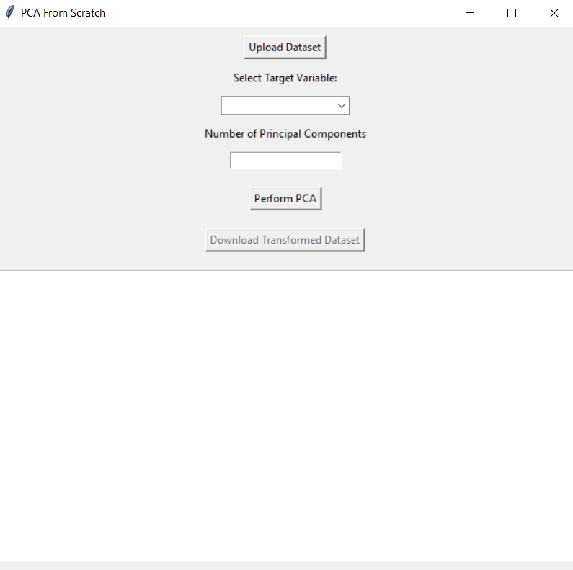
The GUI of Our Project
Our GUI contains at the top a button for uploading the CSV file containing the dataset.
Below it we have “Select Target Variable” where we a dropdown menu for selecting the Target Variable which will be excluded from the dimensionality reduction process.
Below that we have a button “Perform PCA” which basically performs the PCA process after the user clicks on this.
After these steps, the inactive “Download Transformed Dataset” button becomes active which the user can click to download the transformed dataset.
You can observe a blank space below this. This is the output box where three things will be generated after the PCA process is done, these are the first 5 rows of the transformed dataset, the eigenvalues and the eigenvectors of the principal components.

Slide 9
Limitations and Challenges of our Project
Handling large datasets was challenging due to memory constraints.
We used a large dataset on bank transactions that we obtained from Kaggle, our project was unable to handle such large dataset so reduced the size of the dataset and then performed PCA on it.
Information loss is inevitable in PCA, especially when the number of components is small.
Further Extension
Automating various other preprocessing steps such as handling missing values, outliers.
Integrating the PCA implementation with machine learning algorithms.
Adding more features to the GUI, such as provide side-by-side visualizations of the data before and after PCA to help users understand the effect of dimensionality reduction.

Slide 10
Thank You

